Slide 1






Analysing Data From
Goodreads
Presented by: Mahamed Abdulle

Slide 2

Overview
Introduction
How Are Book Ratings Distributed?
Do More Reviews Mean Better Ratings?
Who has released most books this decade?
Most reviewed books this decade (so far!)

Slide 3



Introduction
What is Goodreads?
Goodreads is the world’s largest platform for readers.
It lets users track their reading, discover book recommendations, read and write reviews, and take on reading challenges.
How did I get the data?
Web scraped the data from the Goodreads website

Slide 4

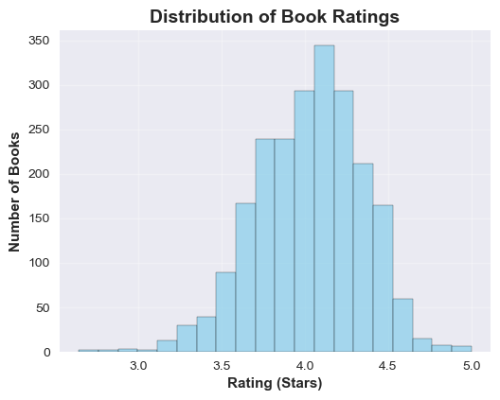

How Are Book Ratings Distributed?
Distribution of book ratings is approximately normal (bell-shaped)
Centre of the distribution is around 4.0 stars
Most books have ratings between 3.5 and 4.5
Indicates generally positive reception towards books released this decade

Slide 5
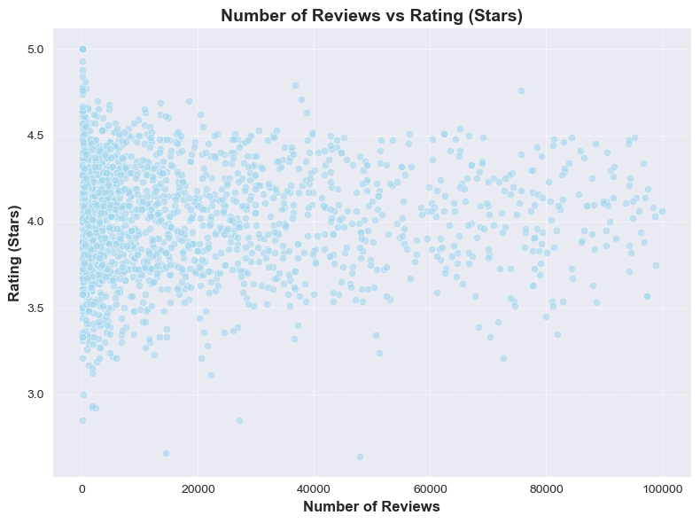
Do More Reviews Mean Better Ratings?
Similar to previous slide, in that most of data lies between 3.5 and 4.5 stars
There is no clear correlation between the number of reviews and the rating the books gets.

Slide 6
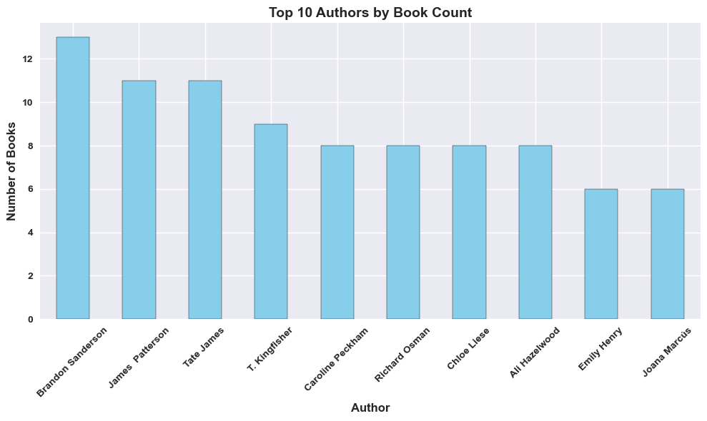
Who has released most books this decade?

Slide 7
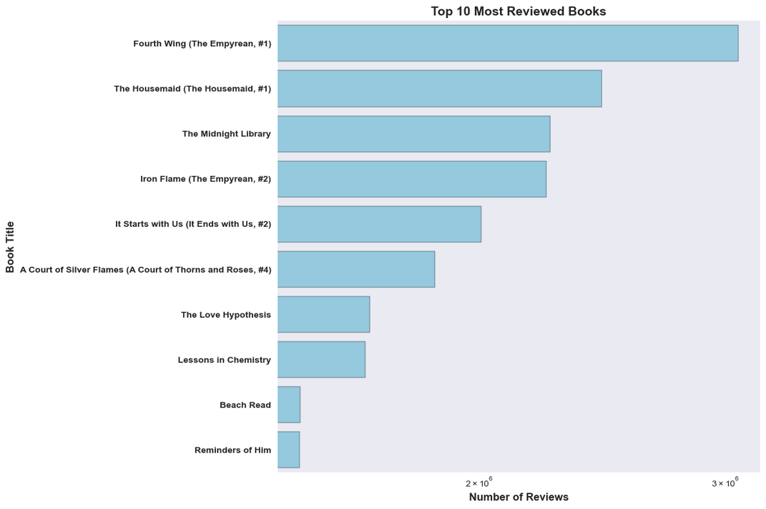
Most reviewed books this decade (so far!)

Slide 8



Conclusions
It would have been better if I was able to make better use of the genres of the books.
01

Slide 9

Thanks For Watching

